Slide 1

REFLEXIO
NAME: | Insa Rubab
MATRICULATION NUMBER: | 9214128
PROGRAM: | BSc. Computer Science
COURSE: | DLBCSPJWD01
LECTURER: | Christian Remfert
EXAM TYPE: | Portfolio
DATE: | 16/04/2025
GITHUB LINK: | https://github.com/Ruby544/reflexio.git

Slide 2
PURPOSE OF THE APP:
This web-based application enhances user productivity by integrating goal setting, habit tracking, and journaling into a unified platform. It enables users to efficiently monitor personal growth and daily activities. Furthermore, the colour palette used throughout the interface is thoughtfully chosen to evoke a sense of calm and tranquility, promoting a focused and peaceful user experience.
Key features:
User Registration & Authentication: Users create secure personal accounts with hashed passwords, ensuring privacy—even the administrator cannot access credentials. Each user can log in/out freely and manage only their own goals, habits, and journal entries. No cross-user data access is permitted.
Goal page: Users can create and manage goals by adding a title, description, priority, and deadline. A progress bar visually tracks completion. Goals can be updated or deleted as needed.
Journal Page: Users can document their thoughts, reflections, or daily summaries. Each entry has a title and description and can be edited or deleted, providing flexibility in personal expression.
Habit Page: Users set habits with a title and a monthly frequency target. They can mark completed days, and track their consistency. Habits can also be edited or deleted, as their routines change.

Slide 3
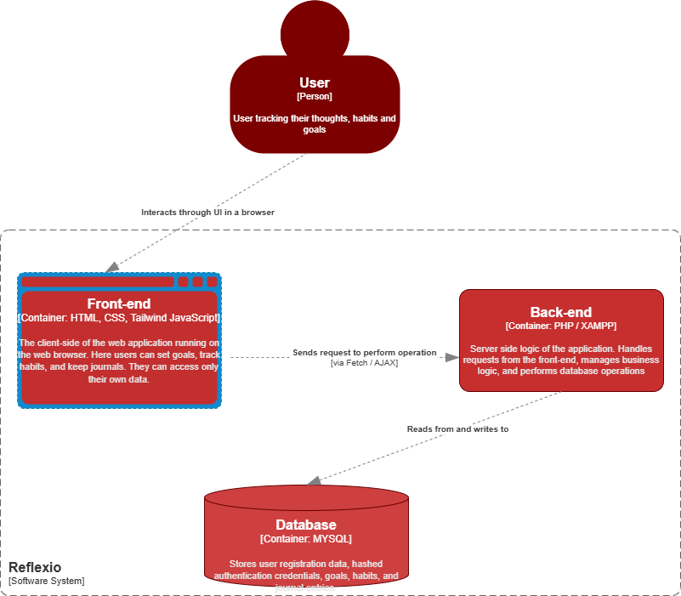
ARCHITECTURE DIAGRAM:

Slide 4
OVERVIEW OF TECHNOLOGY CHOICES
FRONT-END TECHNOLOGIES:
HTML: For structuring the web pages.
CSS and Tailwind CSS: For styling and ensuring a responsive and modern UI.
JavaScript: For adding interactivity, handling UI logic, and making API requests (e.g., form submission, fetching data, requesting and sending data from and to back-end).
Google Fonts: For customized typography to enhance aesthetics.
BACK-END TECHNOLOGIES:
PHP: Handles server-side logic, processes form data, performs CRUD operations, and manages user sessions.
MySQL: The relational database used to store user data, including goals, journals entries, habits, and authentication information.
XAMPP: A local development environment using Apache, MySQL, and PHP for testing and running the web app.

Slide 5

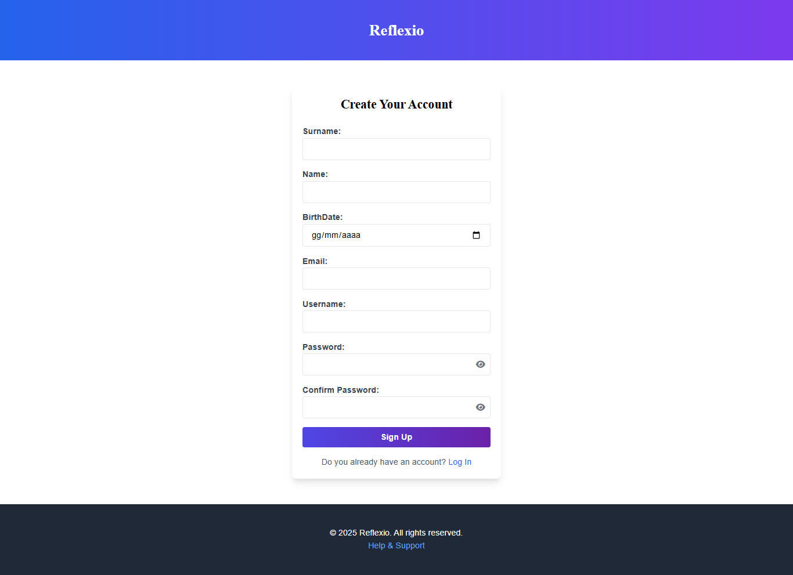
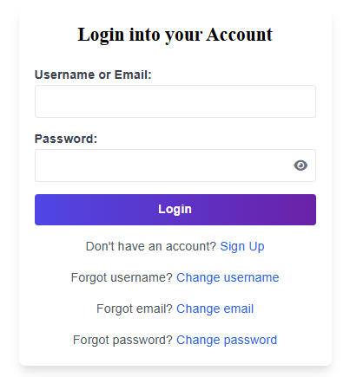
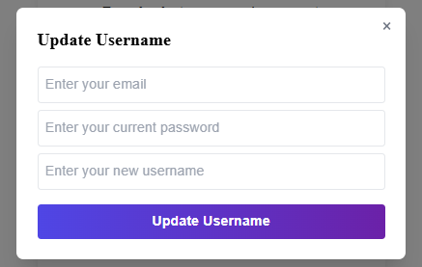
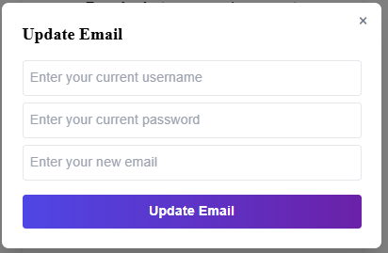
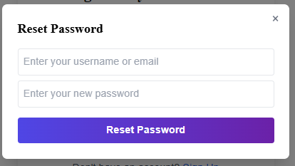
SCREENSHOT OF WEB APP
Sign-Up: Users can create an account by entering their surname, name, email, birthday, and a password (entered twice). Usernames and emails must be unique. Passwords must meet the following criteria: one uppercase letter, one number, one special character, and a maximum of 12 characters.
Index Page: There are also some reviews from users.
Provides an overview of website’s services. Clicking on any feature, the page redirects users to the login page. User reviews are also displayed.
Log-In: Registered users can log in using either their username or email. Options to change username, email, or password are available via popups for users who’ve forgotten their credentials.

Slide 6
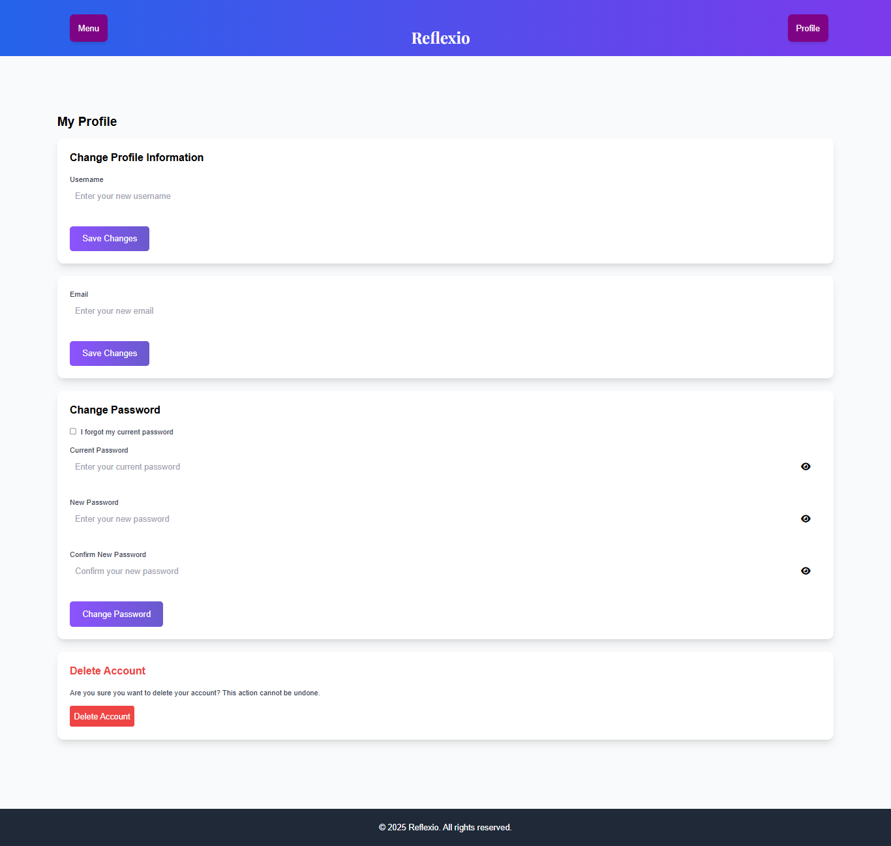
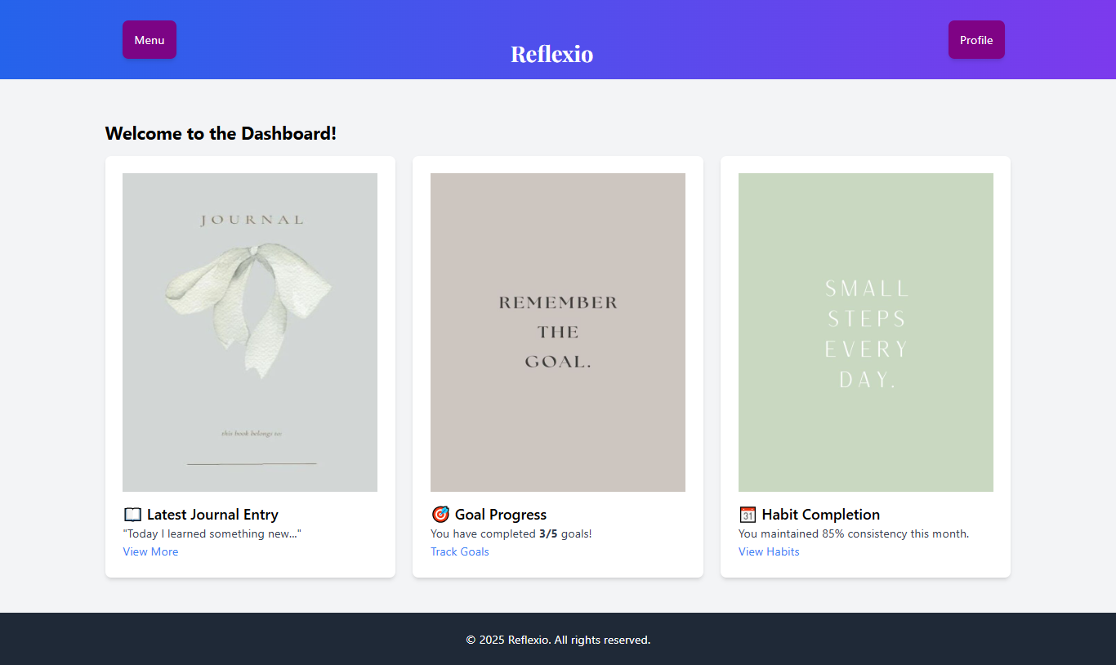
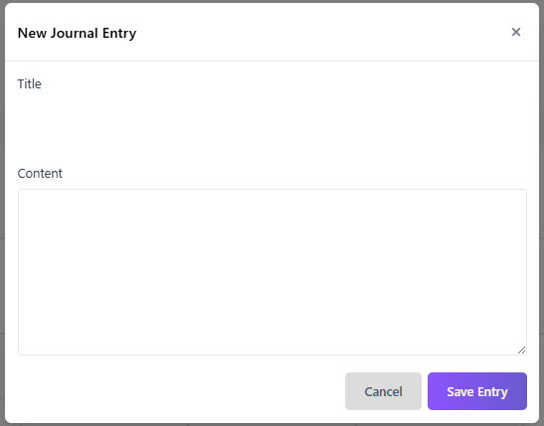
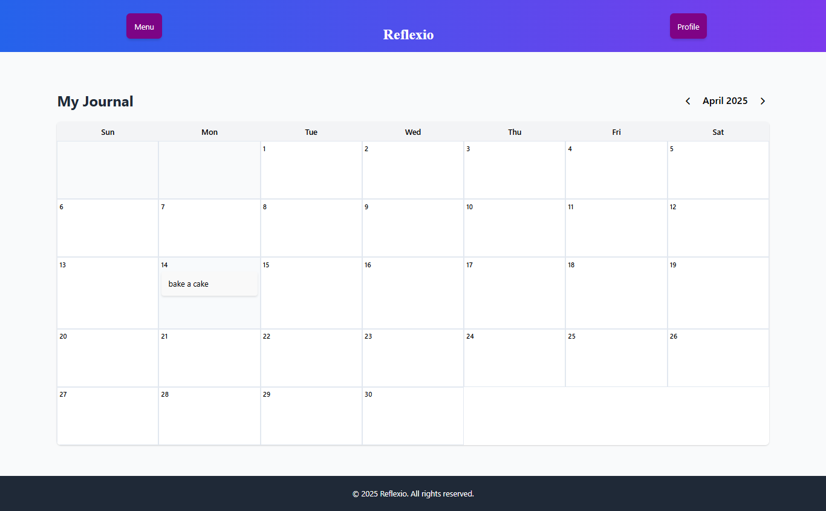
SCREENSHOT OF WEB APP
Dashboard: Users can access features via clickable images or a dropdown menu. A profile dropdown on the right of the navbar allows users to update profile information or log out.
My journal: Users can create a new entry by clicking on a specific day’s cell, which opens a popup. Entries can then be written directly with a title and description.
My profile: Users can update their username, email, or password. If the password is forgotten, a "forgot password" option is available. Users can also delete their account.

Slide 7
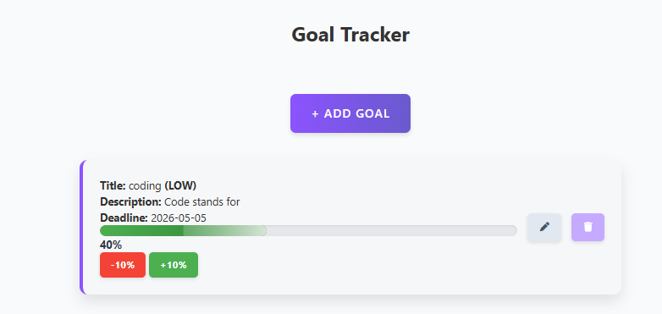
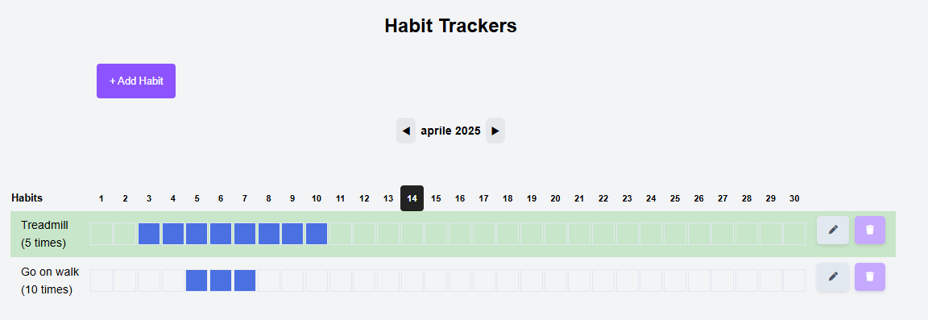
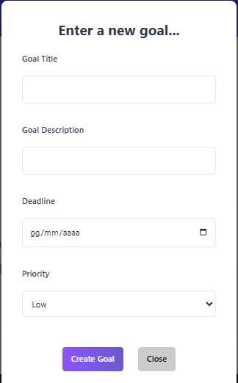
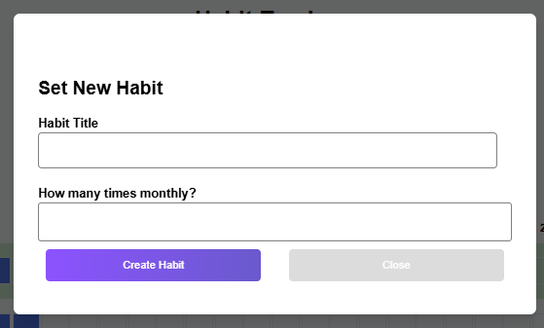
SCREENSHOT OF WEB APP
Habit Tracker: Users can add habits, which appear in a table with as many cells as the current month (with the current day highlighted). Daily habit completion can be toggled. Once the set goal is reached, the row turns green for the month.
Goal Tracker: Users can add goals, which are displayed in a dynamic card showing their details. Progress can be updated in 10% increments using the +10% or -10% buttons.

Slide 8
TEST CASES
Test Case | Action | Expected Result
Succesffull User Registration | User tries to register with valid data | User is successfully reigstered and allowed to add goals, habits, write journal entries and log-in
Successfull Login | User logs in with correct credentials | The user is redirected to the dashboard page and is able to add goals, habits, write journal and log out
Unsuccessful Habit Addition | A user who is not logged-in tries to add a habit | System shows the alert: “Error: Caught Exception: User not logged in.”
Successful Journal Entry | A logged-in user writes an entry with title and Content | The entry is added in the table journal_entries of the server, and is visible on the user screen
Unsuccessful Journal Entry | A logged-in user writes an entry with only title and no content | System shows the alert: “Please enter both title and content”
Successfull Goal Deletion | Logged-in user clicks on the trash icon for a goal | The system shows a confirmation alert: “Are you sure you want to delete this goal?” If the user clicks "OK", the goal is deleted
Successful Change password | A logged-in user who forgot their current password selects "Forgot my current password", enters a new password and confirms it | The password is successfully updated and the message: “Password changed successfully!” appears
Successful Log-out | User clicks on “Log out” in the profile dropdown menu | The user is logged-out and redirected to the index page

Slide 9
PROJECT OVERVIEW & changes made
What Changed | Why It Changed
Removed "Years in Pixels" feature | It was redundant—users can track monthly summaries through habit and journal pages directly.
Removed Monthly Highlights/Reviews section | Journals and habits already offer direct, contextual reflection, making a separate page unnecessary.
Dropped Vue.js framework | Chose to use plain JavaScript to practice and gain deeper understanding of core DOM and event handling.
Switched from PostgreSQL to MySQL (XAMPP) | Stayed with XAMPP instead of emigrating to another database for simplicity, local development ease, and native PHP-MySQL compatibility.
Removed mood/expense tracking | Focus shifted to goal, habit, and journal tracking for a more focused and minimal user experience.

Slide 10
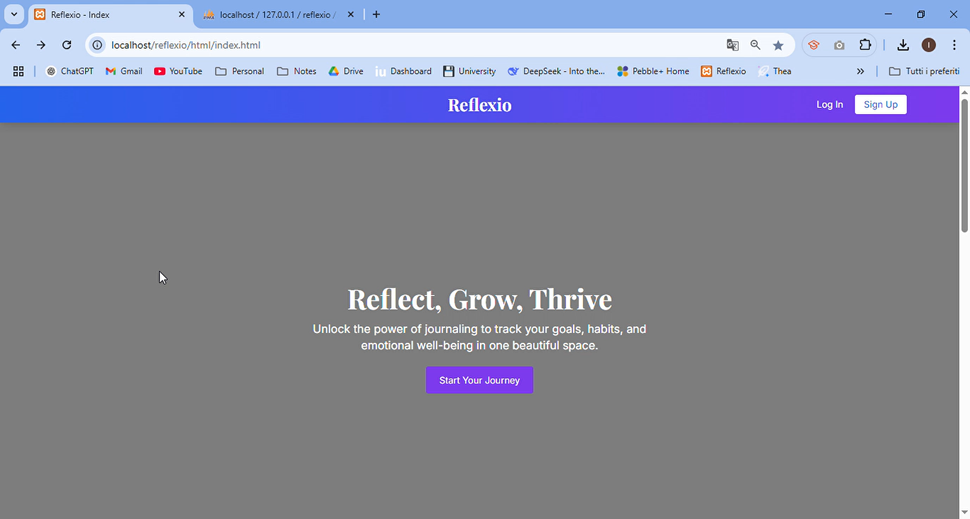
SCREENCAST VIDEO OF THE APPLICATION

Slide 11

Thank you
By Insa Rubab

